Slide 1

Training – Bugs

Slide 2
Agenda
Definition
Relations with Test Cases
Bug tracking Tools
Bug Life Cycle
Bug Components
Reporting a Bug: JIRA
Important Considerations

Slide 3
Context Relations
Definition
  A bug is an error or defect in a piece of software which makes the software not function as expected or according to the defined specifications.
Relation with test cases
  When a test case is executed and the final result is FAIL, the actual result must be documented and a bug must be submitted in the bug tracking tool. This way, the entire team is communicated of the existence of the bug and the needed fix.
Bug Tracking Tool
  This is the tool in charge of managing all bug related information. It generally is used throughout the entire project helping to do the bug follow up work and generate metrics. It is also common for it to include mailing functionality to send emails to the assigned people whenever a change is done to a bug. Jira is a perfect example of this kind of tool. (see below more details)

Slide 4
Context Relations (cont.)
Bug Report
  Before reporting a bug make sure it hasn’t already been reported by someone else and if possible consult it with the team lead or developer assigned to that module or functionality. Try to reproduce the bug several times.
  Make sure to report the bug in a correct and complete manner so that it is easy to reproduce and understand.
Metrics
  A bug is not only a way to notify the development team of an error, it is also a good way to measure which parts of the application work correctly and which don’t.
  A bug is also a good way to measure the performance of the testers work.
Test Cycle
  During SW development the same application must be tested several times
  Starting from the second iteration in addition to executing test cases, retesting of fixed bugs must be performed
  In the Release Notes document in addition to the functionality included in the release, the fixed bugs must be listed as well.

Slide 5
Context Relations (cont.)
Bugs Follow Up
  Bugs follow a defined life cycle during a project with a start and end point
  The bug’s life cycle is closely related to the bug tracking tool used. This workflow will define the transitions a bug can go through between the different states
  A tester must always keep an eye on his assigned bug list
Acceptance Criteria
  In each project the team and client define the acceptance criteria to follow defining the bug’s severities.
  In the same acceptance criteria document the final product acceptance criteria is defined as well indicating how many bugs of each severity will be accepted.

Slide 6
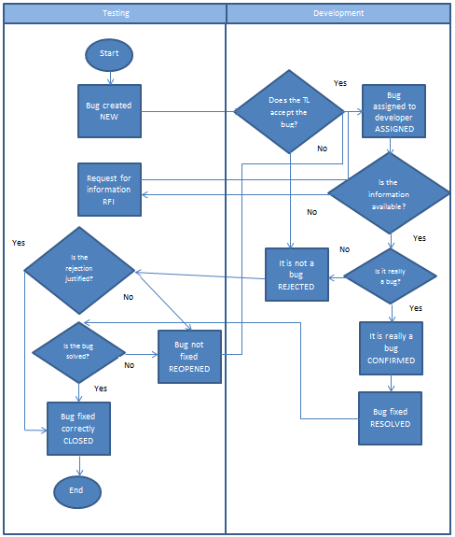
Bugs Life Cycle
Example of a bug life cycle. Remember it will depend on the bug tracking tool selected for the project.

Slide 7
Bugs Life Cycle (cont.)
NEW: A new bug reported by the testing team
ASSIGNED: When a NEW or REOPENED bug reaches the Tech Lead, he assigns it to a developer and changes its status to ASSIGNED
RFI: (REQUEST FOR INFORMATION) The developer has problems understanding or reproducing the bug, so he puts the bug in this state to ask for further details
CONFIRMED: The developer confirms this is a reproducible bug and that he will fix it.
REJECTED: The Tech Lead or developer considers this is an invalid bug which will not get fixed. They must always enter a justification.
RESOLVED: Once the developer has fixed the bug he changes it to this state.
CLOSED: The tester has retested the bug and verifies it has been fixed or rejected with a valid justification.
REOPENED: The bug was not fixed correctly and must be reassigned to a developer.

Slide 8
Bugs Components
ID: An id, generally this is automatically assigned by the tracking tool to identify each bug.
Summary: A brief description of the problem
Description: A detailed description of the problem. It is an extension of the information included in the summary. Should include all the information related to the bug.
Category: Group to which this bug belongs. Depending on the application under test these can be categories, application modules or functionalities.
Severity: Indicates how severe the bug is, this can help understand its impact on functionality. Each project might define different severities or different definitions for the same severity levels.
Steps to reproduce: A detailed walk through the steps necessary to reproduce the bug successfully, they must be included in the bug’s description.
Additional Information: Any other details that could be helpful to understand the bug, such as if it also happens in other modules, operating systems, browsers, if it is related to another bug, etc.
Attachment: You can attach a file if it may help understand the bug as well, this can be a screen shot or a log file for example.

Slide 9
Reporting a Bug
Include as much information as possible
A well reported bug must include:
  The problem
  How to recreate the problem
  Problem related information
What do I need to report a bug?
  Make sure you can reproduce the bug 3 times
  Understand the conditions under which the bug occurs
  Knowing why the bug occurs in the first place is always good
The bug summary must:
  Be only one sentence
  Describe the error and the cause
  Include as much details as possible without becoming too long
The description must include the step by step guide to reproduce the bug

Slide 10
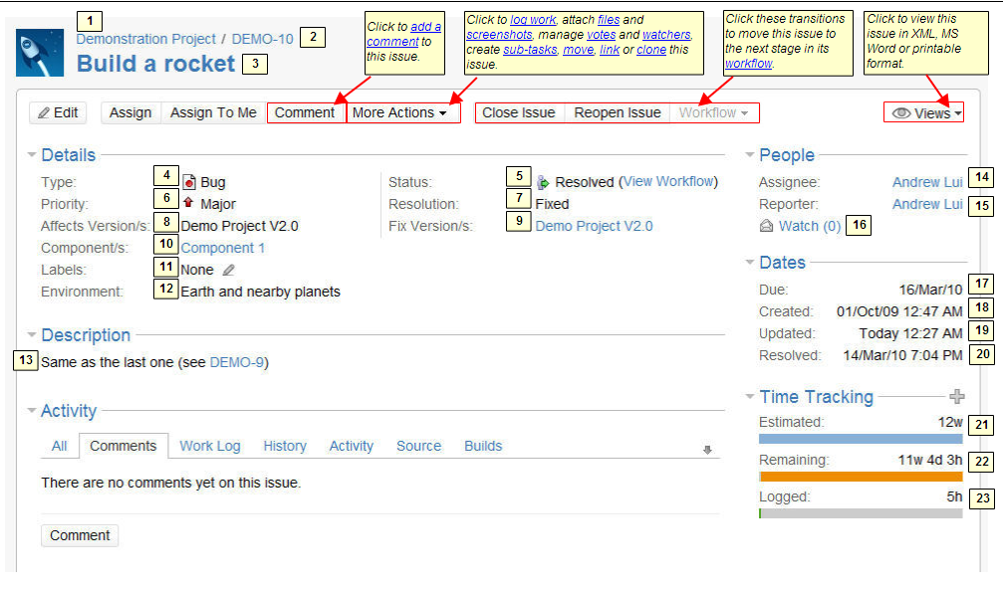
JIRA
Different organizations use JIRA to track different kinds of issues. Depending on how your organization is using JIRA, an issue could represent a software bug, a project task, a helpdesk ticket, a leave request form, etc.
A JIRA issue typically looks like this:

Slide 11
JIRA (cont.)
Some of the most important numbered fields shown in the above screenshot are:
Summary — a brief one-line summary of the issue.
Type — see below for a list of types.
Status — the stage the issue is currently at in its lifecycle. See below for a list of statues.
Priority — the importance of the issue in relation to other issues. (See below for a list of priorities).
Resolution — a record of the issue's resolution, if the issue has been resolved or closed. (See below for a list of resolutions).
Environment (if applicable) — the hardware or software environment to which the issue relates.
Description — a detailed description of the issue.
Assignee — the person to whom the issue is currently assigned.
Reporter — the person who entered the issue into the system.
Resolved — the time and date on which this issue was resolved.

Slide 12
JIRA (cont.)
Issue Type
JIRA can be used to track many different types of issues. The default types are listed below, but please note that your JIRA administrator may have customised.
  Bug — A problem which impairs or prevents the functions of the product.
  Improvement — An enhancement to an existing feature.
  New Feature — A new feature of the product.
  Task — A task that needs to be done.
Priority
An issue's priority indicates its relative importance. The default priorities are listed below; note that both the priorities and their meanings can be customised by your JIRA administrator.
  Blocker — Highest priority. Indicates that this issue takes precedence over all others.
  Critical — Indicates that this issue is causing a problem and requires urgent attention.
  Major — Indicates that this issue has a significant impact.
  Minor — Indicates that this issue has a relatively minor impact.
  Trivial — Lowest priority.

Slide 13
JIRA (cont.)
Status
Each issue has a status, which indicates where the issue currently is in its 'workflow‘:
  Open — This issue is in the initial 'Open' state, ready for the assignee to start work on it.
  In Progress — This issue is being actively worked on at the moment by the assignee.
  Resolved — A resolution has been identified or implemented, and this issue is awaiting verification by the reporter. From here, issues are either 'Reopened' or are 'Closed'.
  Reopened — This issue was once 'Resolved' or 'Closed', but is now being re-examined. From here, issues are either marked In Progress, Resolved or Closed.
  Closed — This issue is complete
Resolution
An issue can be resolved in many ways, only one of them being 'Fixed'. The default resolutions are listed below:
  Fixed — A fix for this issue has been implemented
  Won't Fix — This issue will not be fixed, e.g. it may no longer be relevant.
  Duplicate — This issue is a duplicate of an existing issue.
  Incomplete — There is not enough information to work on this issue.
  Cannot Reproduce — This issue could not be reproduced at this time, or not enough information was available to reproduce the issue.

Slide 14
Important Considerations
Language: Each project defines during the planning phase which language will be used for documentation and communication. All bugs must be reported and documented using that language.
Communication: The tester must be willing to provide all the information necessary so that the developer understands the bug
Detailed: The bug must be as detailed as possible. If something can be done in two different ways, the bug must clarify in which way it was done.
Redaction: Be careful not use words such as “the button”, “the window”, always use the correct name for each element of the application.
Screen Shots: A picture is worth a thousand words!!! Which does not mean a screen shot is enough information by itself!!!

